Slide 1

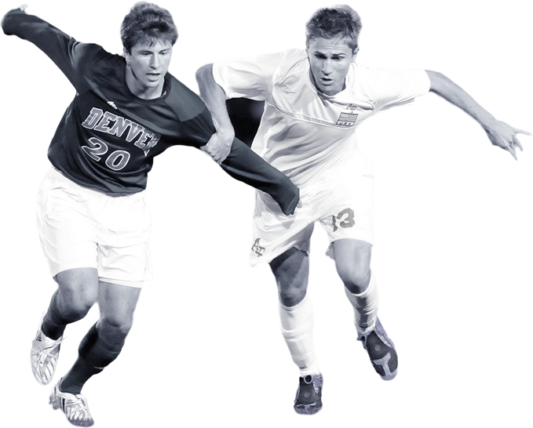

Football Player Market Value Prediction Using Machine Learning Techniques
Barış Samak 070140217
Ahmet Talha Yiğit 070130262

Slide 2


Contents
01
Idea Behind the Project
02
Data Manipulation
03
Model Building
04
Analysing the Results
05
Summary

Slide 3
Idea Behind the Project
To come up with a model more about normalized abilities and less about in-field performance.
Traditional in-field performance statistics can be volatile, illusory and misleading.
Football Manager simulation game attributes.
Aim of the Project
Source of the Problem
Alternative Solution
The richest database of football players around the world. Selling services to big football clubs and has over 1000 professional scouts around the world judging players’ attributes.
Highly overvalued and undervalued players in a fast growing industry.
Problem Definition
Reliability
of Alternative

Slide 4


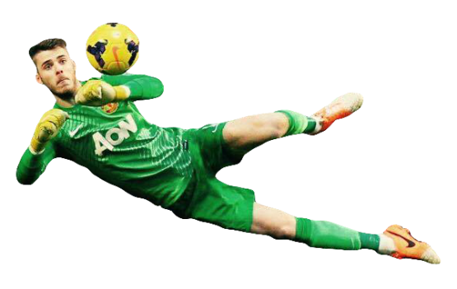
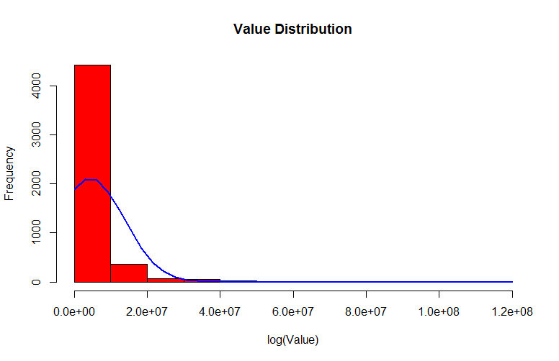



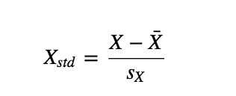



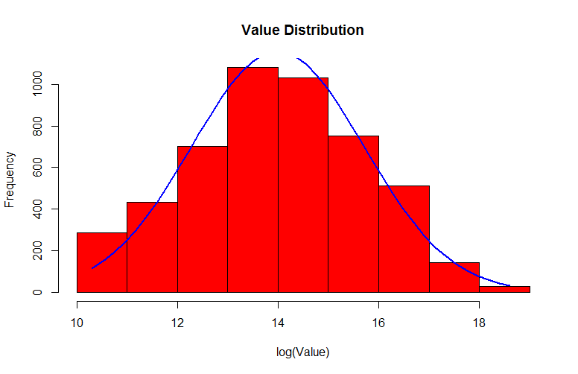



Data Manipulation
League Selection
Data
Standardization
Logarithmic
Transformation of Values
Excluding
Goalkeepers
11 best leagues in the
world
Because of totally different ability
sets
Scaling all attributes around zero
Having a distribution closer to normal distribution

Slide 5



Regression Model Building
Final Regression Model
Interaction Terms and Non-linear Relatonships
Content Here
After all methods are applied to the model, final model found as the result of all of them.
Best Subset Selection
Explaining the relationship between independent variables and dependent variable better to increase accuracy of predictions.
Raw Model
Rigde Regression achieved the best MSE among other methods to choose the best subset.
The first model created with all independent variables.

Slide 6


Decision Trees Model Building
Final Decision Trees Model
Extreme Gradient Boosting
Content Here
Extreme Gradient Boosting Method has been selected as the best among the other alternatives.
Random Forests
Choice of competition winners since it has been found in 2016. One of the best tree boosting method to achieve the best accuracy.
Recursive Binary Splitting
Decreasing the power of stronger independent variables.
Greedy method to grow a big tree.

Slide 7



Neural Networks Model Building
Final Neural Networks Model
Activation Function
Content Here
The model was not very successful because of its tendency to undervalue all players.
Dropout Rate
Rectified Linear Unit (ReLU) has been used.
Model Architecture
Different dropout rates for every hidden layer have been chosen to avoid overfitting.
The number of hidden layers and nodes have been determined.

Slide 8
Ensemble Model and Inflation
Ensemble Model
Weighted average ensembling method has been used.
The ensemble model has been created by using regression model and decision tree model.
Yearly Inflation
The inflation rate has been calculated by looking at the value changes of top 20 football players for the past year.
Regression Model
Decision Tree Model
Inflation
Final Model
30%
70%
+29%

Slide 9
Analysing the Results
with up to date examples

Slide 10
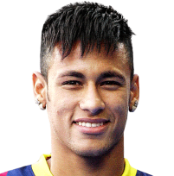
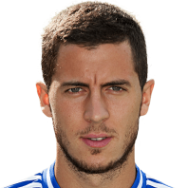
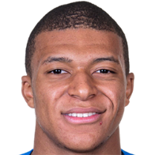


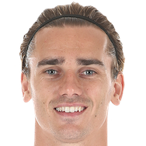
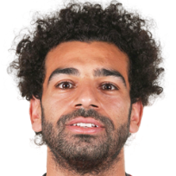
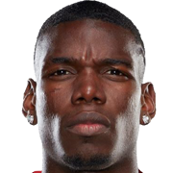
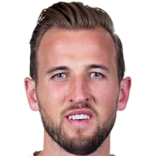
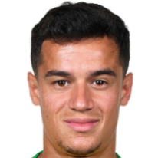
KPMG vs. Our Model
KPMG
Our Model
KPMG
Our Model
1.
2.
Neymar, 26, PSG
6.
7.
Eden Hazard, 28, Chelsea
2.
4.
Kylian Mbappe, 20, PSG
7.
8.
Kevin De Bruyne, 27, Manchester City
3.
1.
Lionel Messi, 32, Barcelona
8.
6.
Antoine Griezmann,27,Athletico Madrid
4.
16.
Mohammed Salah, 26, Liverpool
9.
3.
Paul Pogba, 25, Manchester United
5.
11.
Harry Kane, 25, Tottenham
10.
12.
Philippe Coutinho, 26, Barcelona

Slide 11
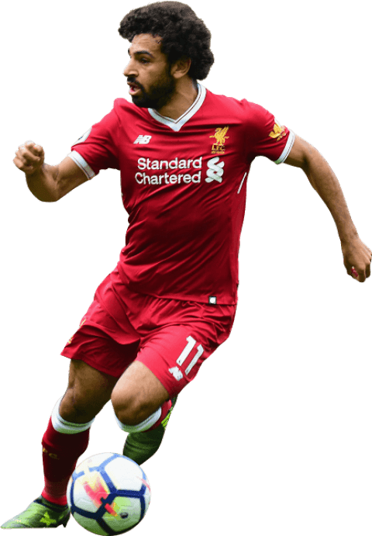
Salah Case
Start of 2017-2018 Season
Start of 2018-2019 Season
Market Value
Market Value
35 M €
150 M €
Our Valuation
Our Valuation
50 M €
90 M €
Undervalued
Overvalued

Slide 12
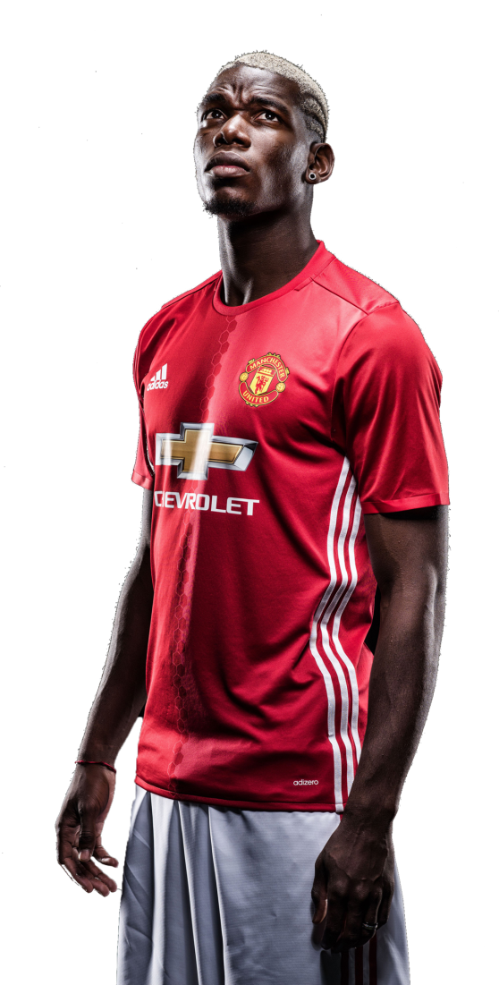

Pogba Case
Different Valuations
Performance in 2018-2019 Season
The most expensive transfer until 2016
With Mourinho
105 M €
3 Goals, 3 Assists in 14 Matches
Current Market Value
After Mourinho
80 M €
4 Goals, 4 Assists in 5 Matches
Significant Decrease in Value
Significant Increase in Performance
Our Valuation
«The tactics we were using in the past were tough for me. I like to be able to attack»
Paul Pogba, 13.01.2019
125 M €

Slide 13
















Recent Transfers in 2019
 | Name | Age | Position | From | To | Market Value | Transfer Fee | Our Valuation
 | Giorgian De Arrascaeta | 24 | AMC | Cruzeiro | Flamengo | 9 M € | 15 M € | 14.296.753,09 €
 | Manolo Gabbiadini | 26 | AMR | Southampton | Sampdoria | 10 M € | 12 M € | 12.140.448,04 €
 | Garry Rodrigues | 27 | AMR | Galatasaray | Al-Ittihad | 7,5 M € | 9 M € | 9.409.928,07 €
 | Lucas Paqueta | 20 | AMC | Flamengo | AC Milan | 15 M € | 35 M € | 29.911.751,10 €
 | Lisandro Magallan | 24 | DC | Boca Juniors | Ajax | 6 M € | 9 M € | 10.082.539,99 €
 | Rodrigo Caio | 24 | DC | Sao Paulo | Flamengo | 9 M € | 5 M € | 4.817.187,36 €

Slide 14
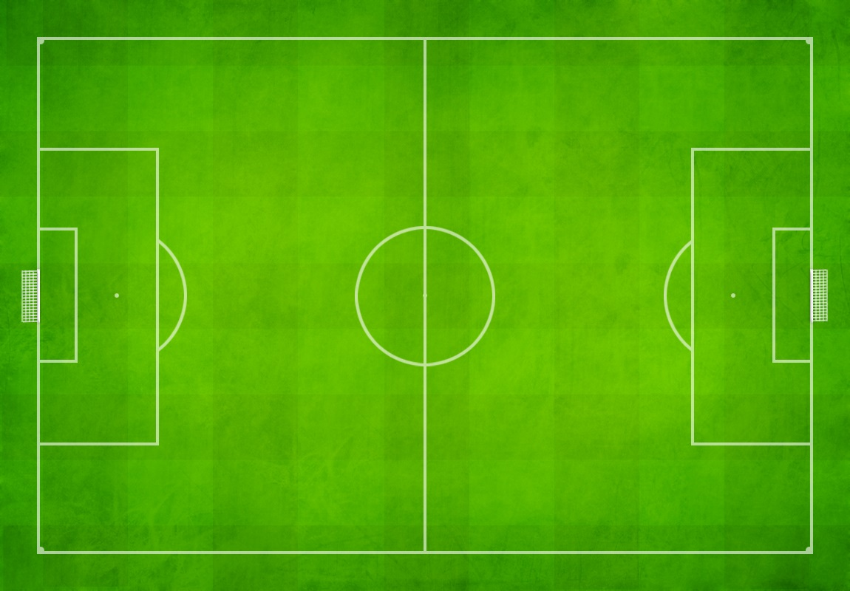
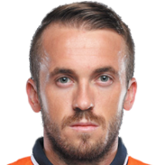


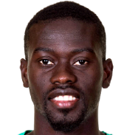
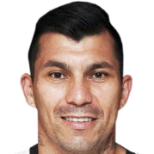


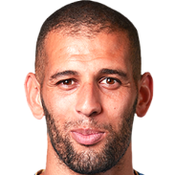
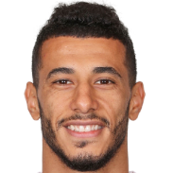

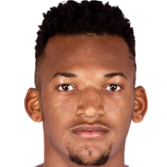



TSL Most Valuable Team
Edin Visca
10.5 M €
Junior Caicara
4.5 M €
Badou Ndiaye
11,5 M €
Gary Medel
9 M €
Islam Slimani
11 M €
Younes Belhanda
9.5 M €
Jailson
8,75 M €
Domagoj Vida
8.5 M €
Adem Ljajic
11 M €
Caner Erkin
4 M €

Slide 15
Summary
Technical
3 different Machine Learning models have been built and 2 of them selected to create the final ensemble model. To do this 858 lines of code has been written in R programming language and Keras library with TensorFlow backend has been used to create Neural Network Model.
Possible Implications in Real Market
The final model is a trustworthy benchmarking model for valuing football players based on their intrinsic abilities. Further judgments about the player and the market should be done by football clubs to make better use of the insights provided by this model.
Further Improvements
Neural Networks method can be applied in a better way and achieve better predictions.
The determination of inflation can be improved.

Slide 16
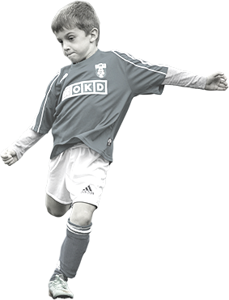
Thank You for Everything !

